Slide 1
Introduction to Oil & Gas Topics
Note: Unashamedly stolen

Slide 2
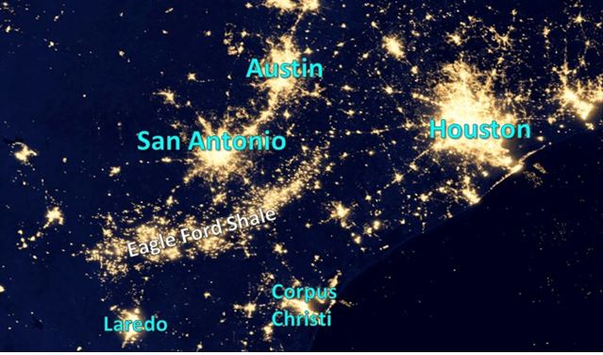
Satellite Image – Eagle Ford Shale

Slide 3
Types of Mineral Interests
Royalty Interest | Working Interest | Overriding Royalty Interest
Created when land owner leases operating rights to mineral property. Land owner retains a royalty interest in lease agreement. | Created when operating rights to mineral property are leased from land owner. | Created when interest is “carved out” of working interest.
Permanent interest – landowner’s rights continue even if lease is terminated or abandoned. | Temporary interest – limited to term of the lease unless oil & gas is produced. As long as operations and production continues, lease and working interest continues. If, however, well is not drilled during lease term, lease expires and working interest reverts back to landowner. | Temporary interest – limited to term of lease and life of working interest. If lease expires, working interest reverts back to landowner and ORRI expires.
Low risk - Liable for production taxes, but not costs or responsibilities of exploration, development, or operation. | High risk - Liable for cost and responsibilities of exploration, development, and operation. | Low risk - Liable for production taxes, but not costs or responsibilities of exploration, development, or operation.

Slide 4
Example 1
Landowner – 100% working interest
Landowner – 20% royalty interest
Operator – 80% working interest

Slide 5
Example 2
Landowner – 100% working interest
Landowner – 20% royalty interest
Operator – 80% working interest
Geologist – 5% ORRI
Operator – 75% working interest

Slide 6
Phases of Operations
Acquisition of rights
Exploration
Drilling
Production

Slide 7
Phase 1 – Acquisition of Rights
Lease mineral rights
Operator pays a lease bonus payment to land owner for working interest
Tax Treatment-
Land owner – rent income; not subject to depletion
Operator – capitalized as leasehold cost and recovered thru depletion
Operator pays a delay rental payment to land owner to extend time to drill
Tax Treatment-
Land owner – rent income; not subject to depletion
Operator – capitalized as leasehold cost and recovered thru depletion

Slide 8
Phase 2 – Exploration
Geological & geophysical costs (G&G)
Tax Treatment - Operator
Amortized over 24 months using half-year convention (i.e. 25% year 1, 50% year 2, 25% year 3)
No write-off for abandonment; continue to amortize even if leasehold cost is written-off

Slide 9
Phase 3 - Drilling
Intangible drilling costs (IDC)
First year election to expense
Either (1) capitalize and recover through depletion (or depreciation under some circumstances) or (2) elect to expense
Elect by expensing; IRS doesn’t require an election statement to be attached to return
Election is binding for subsequent years
If no election to expense in first year, then must capitalize all future IDC and recover thru depletion
If election to expense in first year, then must expense all future IDC but can still make second annual election to capitalize and amortize over 60 months
Annual election to capitalize (Only if first year election is made to expense IDC)
If election to expense is made in the first year of IDC, taxpayer can make secondary annual election under Sec 59(e) to capitalize and amortize some or all IDC over 60 months
Must attach an election statement
Reduce AMT tax or save deductions for future years

Slide 10
Phase 4 - Production
Income
Working interest income
Royalty interest income
Expenses
Production taxes
Lease operating expenses (LOE)
Depreciation
Lease and well equipment, storage tanks (7 year life)
Amortization, Depletion
Allocated overhead
Workover expense
Rework/redrill to increase production
Different from IDC; not subject to Sec 1254 recapture

Slide 11
Depletion Expense
Greater of cost depletion or percentage depletion
Cost depletion
Units of production method
Units sold during year / (units sold during year + reserves at end of year)
Fraction then multiplied by remaining basis of leasehold cost as of end of year
Percentage depletion
15% of gross revenue, limited to 100% of net income of property
Additional limitation of 65% of adjusted gross income
May carry forward amount limited under the 65% limitation

Slide 12
Example – Cost Depletion
Remaining basis in leasehold cost (net of accumulated depletion) | Cost depletion rate | Cost depletion
$40,000 | 10% | $4,000
$100,000 | 3% | $3,000
$0 | 20% | $0

Slide 13
Example – Percentage Depletion
Gross revenue | Net income before depletion | Percentage depletion @ 15% (limited to net income)
$100,000 | $70,000 | $15,000
$100,000 | ($10,000) | $0
$100,000 | $20,000 | $15,000

Slide 14
Example – Greater of Cost or % Depletion
Cost Depletion | Percentage Depletion | Tentative Depletion (greater of cost or %) | Depletion Recorded to Books | % Depletion in Excess of Basis
$4,000 | $15,000 | $15,000 | $15,000 | $0
$3,000 | $0 | $3,000 | $3,000 | $0
$0 | $15,000 | $15,000 | $0 | $15,000
Tentative depletion
Total depletion expense allowed as a deduction by taxpayer
Consists of (1) depletion recorded to books, and (2) % depletion in excess of basis
Depletion recorded to books
Reduces remaining basis in leasehold cost
Posted as an M-1 book to tax adjustment on partnership tax return
Depletion passes thru on K-1 as informational item
Percentage depletion in excess of basis
Not posted to books and doesn’t reduce basis because no basis remaining
Passes thru on K-1 as informational item
Subject to 65% taxable income limitation
Disallowed depletion carried forward

Slide 15
Other Payments Received by Land Owner
Payment for right of way & pipeline easements (limited term of years)
Tax Treatment by land owner -
Reduce basis of land then treat excess, if any, as gain on sale
Capital gain if land not used for business; Sec 1231gain if land used for business and held more than one year
Basis allocation should be based upon specific allocation of the affected acres, not the entire acreage owned
Payment for damages to land
Tax Treatment by land owner -
Reduction of basis of land then treat excess, if any, as capital gain or Sec 1231 gain if used for business
Payment for damages to crops or for loss of profits
Tax Treatment by land owner -
Ordinary income

Slide 16
Other Payments Received by Land Owner
Payment for damages to personal property & livestock
Tax Treatment by land owner -
Involuntary conversion
Payment for gravel sales
Tax Treatment by land owner -
Ordinary income
Potentially eligible for a percentage depletion rate of 5% under IRC 613(b)(6)(A)
Payment for water sales
Tax Treatment by land owner -
Ordinary income

